Slide 2
Purpose of PIF V
Create a unified vision by bringing together critical mass of individuals and organizations to identify priority conservation actions for priority migratory birds.
Identify key conservation actions throughout all stages of annual life cycle of migrants.
Develop priority projects to be included in “Conservation Business Plans.”
Enrich communication between bird conservation partners throughout the Americas.

Slide 3
PIF V Conference - August 2013
Three days in Snowbird, Utah
Eight different breakout groups
Breakouts based on wintering ground geographies.
Winter geographies linked to breeding geographies – Full Life Cycle Approach
250 Participants/ 100 agencies or organizations
48 from Latin America/ 17 countries represented

Slide 4
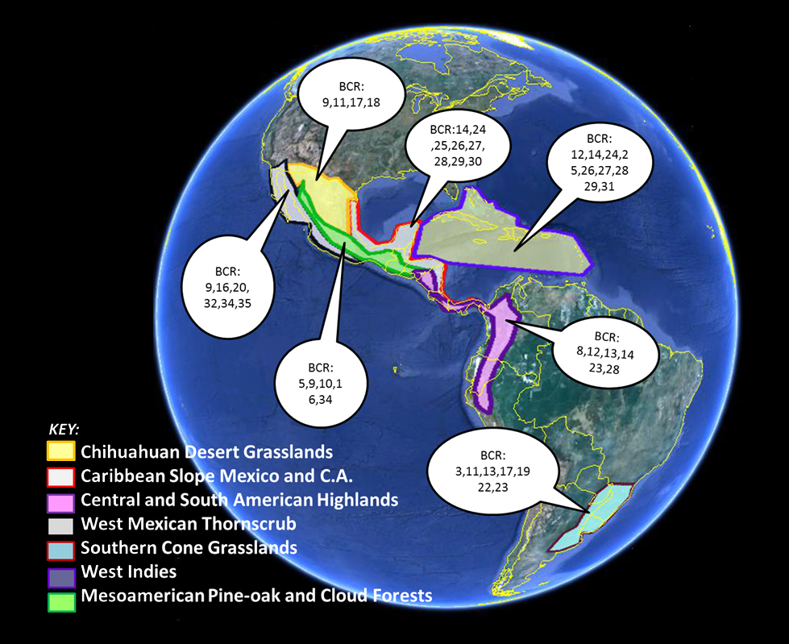
Geographies are based on wintering areas.
Focal breeding grounds are related to wintering grounds via BCR.

Slide 5
Eight Geographic Breakouts
GULF-CARIBBEAN SLOPE – MX & C. America ⬄ EASTERN DECIDUOUS FORESTS, primarily Atlantic and Gulf Coastal Plains
CHIHUAHUAN DESERT GRASSLANDS ⬄ WESTERN GREAT PLAINS and PRAIRIES
CENTRAL and SOUTH AMERICAN HIGHLANDS ⬄ APPALACHIAN and NORTHEASTERN HARDWOOD and MIXED FOREST REGIONS, north to the BOREAL REGION
WEST MEXICAN THORNFOREST ⬄ ARIDLANDS OF TEXAS and SOUTHWESTERN U.S
SOUTHERN CONE GRASSLANDS ⬄ EASTERN N. AMERICAN GRASSLANDS (tallgrass and east) and ARCTIC TUNDRA
WEST INDIES ⬄ variety of EASTERN AND BOREAL FOREST REGIONS
MESOAMERICAN PINE-OAK AND CLOUD FOREST ⬄ WESTERN CONIFEROUS FOREST REGIONS of U.S. and Canada
PACIFIC SHOREBIRDS ⬄ U.S. AND CANADA PACIFIC COASTAL areas

Slide 6
Conservation Business Plans
Situation analysis; key targets with long-term goals; key threats identified
Conservation projects that are well-defined and able to be implemented
Prediction of a project’s measurable impacts and costs
A discussion of the general risks that could affect the project and its strategic approach

Slide 7
Contents of the Conservation Business Plan
Summary
Goal Identification for Conservation Targets
List of Specific Threats
Prescribed Actions by theme
The Project Matrix
(See “Conservation Business Plan template” @ www.PIFV.org for more information on the template.)

Slide 8
Nine Breakout Teams
Each Breakout Team will have:
Team Leaders (two to four people)
Team Members (determined by the leaders)
A Facilitator (to assist during PIF V)
A Translator
Liaison with PIF V Steering Committee
… and 50-60 participants at the PIF V meeting.

Slide 9
Responsibilities of the Team
Prior to the Conference, assemble background information and begin to fill out the Conservation Business Plan template
During PIF V, provide guidance and run the breakout sessions
After PIF V: potentially continue as a working group

Slide 10
Contents of the Conservation Business Plan
1. Summary
General Introduction
Description of geographic areas covered – north and south
List of the conservation targets: Species, habitat types, ecosystem functions
Brief description of the current situation and conservation need.
Brief citation of major prior conservation plans or other key documents
(Section length = approximately 2-4 pages; draft to be filled out prior to PIF V meeting.)

Slide 11
Contents of the Conservation Business Plan
2. Goal Identification for Conservation Targets
Conservation targets = those species, habitats or ecological processes that the Conservation Business Plan intends to focus on and protect.
Formal goals established for each Conservation Target. States the desired future condition of the target -- quantitative, time-limited, impact-oriented, specific and linked to the target. For example: “Increase the current Golden-winged Warbler population by 50% by 2050.” (If possible, identify secondary goals, for example: “Increase the amount of early successional breeding habitat for Golden-winged Warbler from two million acres to three million acres by 2050”).
(Section length = approximately 2 – 4 pages. Begin with population goals established by prior PIF and working group plans. Draft to be filled out prior to PIF V meeting.)

Slide 12
Contents of the Conservation Business Plan
3. List of Specific Threats:
List the key threats that affect the conservation targets.
Identify the sources of those threats; the significance; and how they impact the target (e.g. reproductive success, survivorship, etc.)
Select the top priority threats (3-6) that the Conservation Business Plan will focus on.
Threats should be considered through the full annual life cycle scale of the given target species – wintering, breeding and transit.
This section can address direct threats, indirect threats and even major opportunities to advance conservation. The Miradi approach can be used if desired.
(Section length = approximately 3-6 pages; draft to be filled out prior to PIF V meeting.)

Slide 13
Contents of the Conservation Business Plan
4. Prescribed Actions by theme:
Organize each breakout group’s discussion for PIF V prior to the meeting to allow fruitful discussion.
Suggestion: Set up the Project Matrix by listing each the priority threat and then discuss projects and actions by each Annual Life Cycle stage (wintering, breeding, transit).
At the beginning, the Project Matrix may look something like this:
Priority threat 1 X wintering ...
Priority threat 2 X wintering
Priority threat 3 X wintering
Priority threat 1 X breeding
Priority threat 2 X breeding
Priority threat 4 X breeding
Priority threat 2 X transit
Priority threat 4 X transit

Slide 14
Contents of the Conservation Business Plan
4. Prescribed Actions by theme - continued:
Discuss general strategies and approaches for each threat. Review:
Species-specific needs
Habitat projects
Direct land protection projects
Working landscape projects
Policy/regulatory projects:
Socio – Economic/Community engagement projects
Threat reduction projects
Knowledge, Monitoring and Evaluating projects
Feed results and recommended projects into the Project Matrix,
NOTE: For each conservation target, ensure that the Full Annual Life Cycle is considered as the team addresses each threat (wintering, breeding, transit). Some example projects can be drafted prior to the PIF V meeting, most will be filled in during the breakout sessions.

Slide 15
5. The Project Matrix
For each project, begin to fill in a row of the Project Matrix. (This Matrix is open for review, comment and improvement) Under each list key activities for each relevant theme in a tabular form:
Key Threat (use as the organizing principle) | Stage W, B, T | Objectives | Key Theme and Strategy | Cons. targets | Project | Activity
Which of the main threats is being addressed here? | List if: Wintering Breeding and/or Transit work | What is the overall objective? | What type of work (theme from above) and what is the strategy is being used? | What are the conservation targets | What is the project name? | What are the activities?
Lack of wintering habitat and accelerating habitat degradation | Wintering | Increase wintering habitat for shorebirds in Argentina – by XXX acres overall by 2025. | Community engagement: Engage rice farmers in Argentina to promote conditions that support certification | All target shorebirds in the Grassland group | Creating bird-friendly rice fields in Argentina through farmer certification | Farmers are informed and provided incentives to move their rice field towards certification
Timeframe | Anticipated Costs | Total Costs | Evaluation | Comments
What time period? How long will it take/ | Cost/year | Total project costs | How will the project be evaluated? | General comments, next steps, list of potential actors, risks
Two years | $75,000 | $150,000 | Number of farmers engaged in certification; number of acres
Matrix continues on next slide =>

Slide 16
5. The Project Matrix, continued
=> Matrix continued from previous slide
 | Results of the Activity | Long-term Outcome | Timeframe | Anticipated Costs | Total Costs | Evaluation | Comments
 | What is the measurable result/deliverables? | What are the measureable long-term impacts/outcomes expected? | What time period? How long will it take/ | Cost/year | Total project costs | How will the project be evaluated? | General comments, next steps, list of potential actors, risks
 | 6 workshops; 150 farmers enlisted; 3000 acres put into certified bird-friendly rice management by 2015. | X% acres added toward overall Argentina habitat goal. | Two years | $75,000 | $150,000 | Number of farmers engaged in certification; number of acres

Slide 17
Timeline
Spring 2013 - Assemble Geographic Focal Teams. Draft first sections of Conservation Business Plans. Team training and orientation
August 2013 – PIF V Conference in Snowbird Utah
August – January 2014 – Revision and refinement of Conservation Business Plans. Development of Projects.
January 2014 – Conservation Business Plans to be submitted to PIFV Coordinating Committee.
Spring 2014 – Plans and Projects assembled and “published”. Working Groups continue to add projects and push forward on implementation.

Slide 18
Results
Conservation Business Plans for each linked region; a full life-cycle approach.
Every Plan will have Library of Priority Conservation Projects
A “Blueprint for the 21st Century”.
Increased communication and partnerships between organizations throughout the Americas, ongoing Working Groups.
Notes:
A Conservation Business Plan for each region that will provide guidance to the bird conservation community, international development and funding agencies, and governments.
Within each plan, a Matrix/Library of priority conservation projects necessary to reverse the decline of priority migratory bird species.
A “Blueprint for the 21st Century”.The projects in the Matrix, combined with the background information gathered before the meeting, will serve as “business plan” style Conservation Action Plans for each geographic linkage.
Increased communication and partnerships between organizations throughout the Americas.

Slide 19
Moving Forward
Suggest bi-weekly meetings with your team
Next Call – Wednesday May 22 at 3 o'clock NYC time
Drafts completed by May 20 for 1) Summary Introduction, 2) Conservation Targets identified and 3) preliminary Conservation Goals stated for each Breakout team

